Slide 1
Programmable Interval Timer - 8254

Slide 2

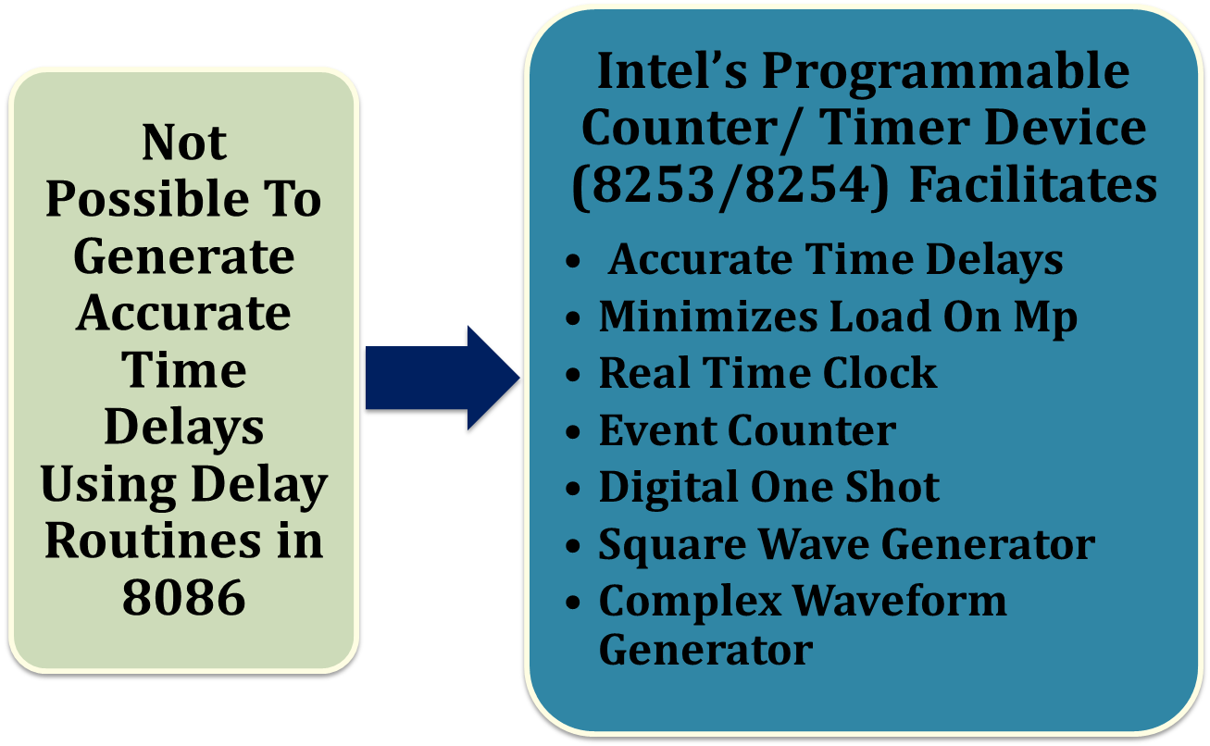

Slide 3

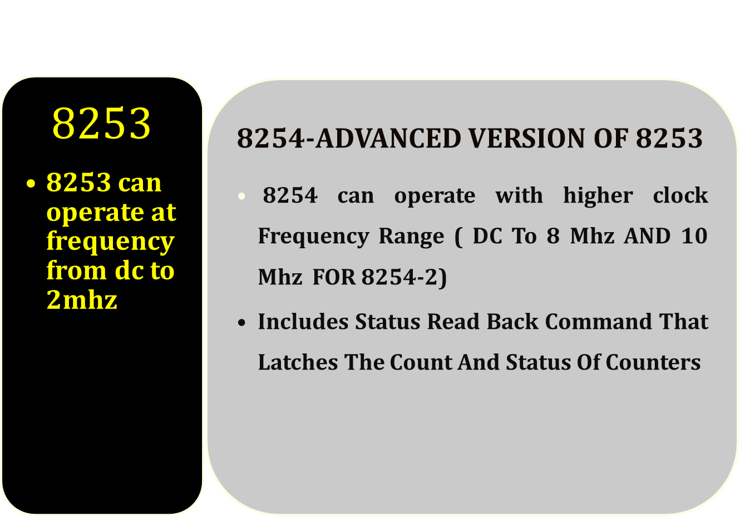

Slide 4
Features
Three Independent 16-Bit Counters,
Clock input upto 10 MHz,
Status Read-Back Command,
Six Programmable Counter Modes,
Binary or BCD Counting,
Single +5V Supply,
Superset of PIT-8253.

Slide 5
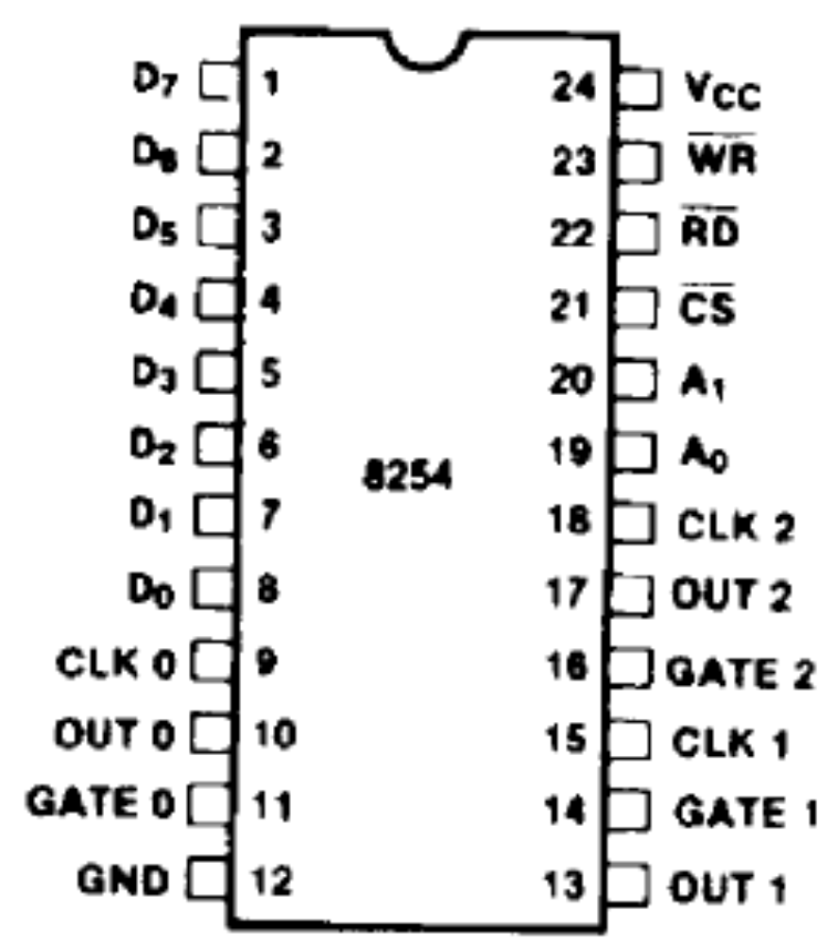
Pin Diagram

Slide 6
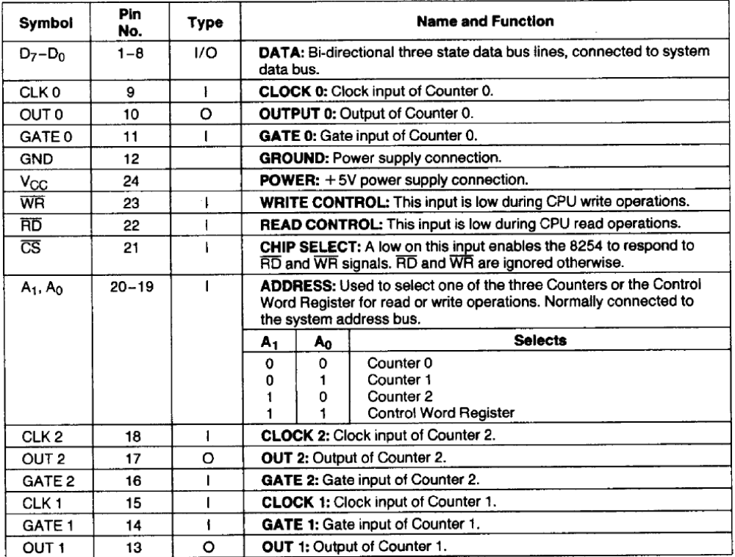
Pin Description

Slide 7
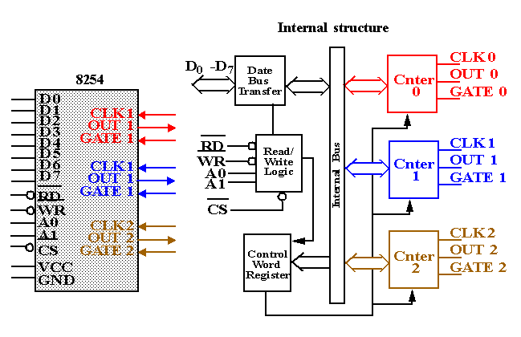
Block Diagram of 8254

Slide 8
Internal Blocks of Counter
Count Register (CR) to store count (CRL & CRM),
Counting elements (CE) are used for counting,
Output Latch (OLL & OLM) to latch the count in CE,
The Control Word Register is not part of the Counter itself, but its contents determine how the Counter operates.
The status register, when latched, contains the current contents of the Control Word Register and status of the output and null count flag.

Slide 9

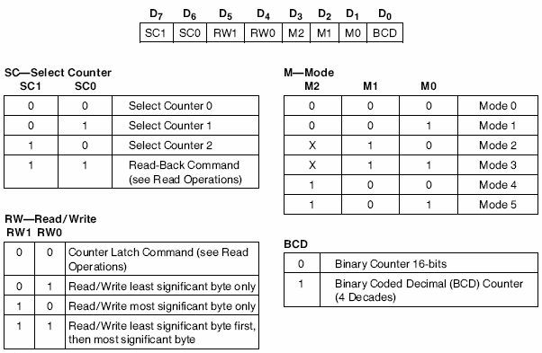

Slide 10
8254 Programming
Each counter is individually programmed by writing a control word, followed by the initial count.
The control word allows the programmer to select the counter, mode of operation, binary or BCD count and type of operation (read/write).

Slide 11
WRITE Operation
Control Word to Control register
Initial count must follow the count format specified in the Control Word (least significant byte only, most significant byte only, or least significant byte and then most significant byte).

Slide 12

READ Operation
Three Possible Methods to read counters
Simple Read Operation,
Counter Latch Command,
Read Back Command.
Note: Two I/O read operations have to be performed to get first Lower Byte and then higher byte of count.

Slide 13

Simple Read Operation:
After inhibiting counter using GATE or CLK input we can read count
Counter Latch Command:
D5 D4 = 0 0 Designates the counter latch command
SC1 SC2 = Specify counter to be latched.
X – Don’t care bits must be 0 to ensure compatibility with future Intel products.

Slide 14
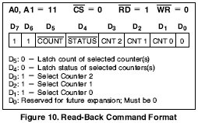
Read Back Command:

Slide 15
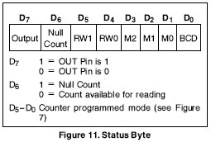
Status Byte

Slide 16
Interleaved Read and Write Operations:
Valid sequence for read and write of the same
counter set for two byte count:
Read least significant byte,
Write new least significant byte,
Read most significant byte,
Write new most significant byte.

Slide 17
Modes of 8254
Six Different Modes
Mode 0: Interrupt On Terminal Count
Mode 1: Hardware Retriggerable One-shot
Mode 2: Rate Generator
Mode 3: Square Wave Mode
Mode 4: Software Triggered Strobe
Mode 5: Hardware Triggered Strobe (Retriggerable)

Slide 18
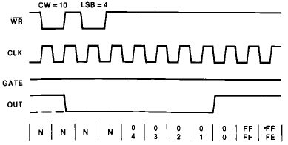
MODE 0 – Interrupt on Terminal Count
N : Undefined Count

Slide 19
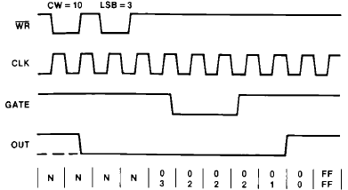
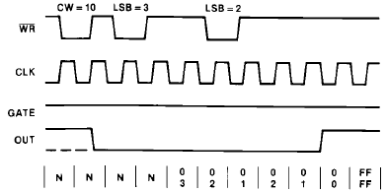

Slide 20
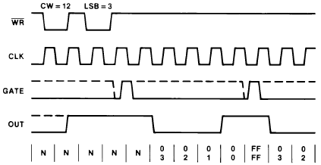
MODE 1: Hardware Retriggerable One Shot.

Slide 21
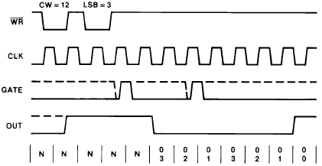
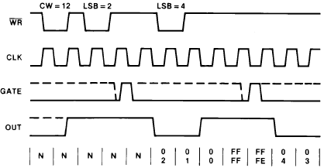

Slide 22
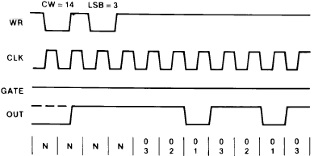
MODE 2: Rate Generator

Slide 23
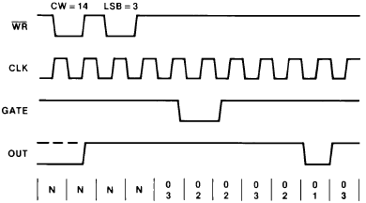
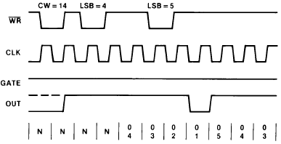

Slide 24
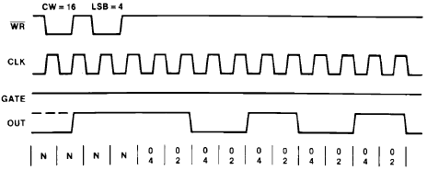
MODE 3: Square Wave Mode

Slide 25
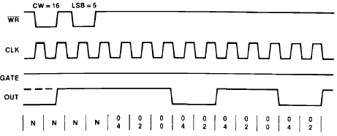
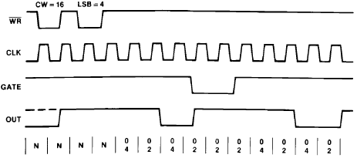

Slide 26
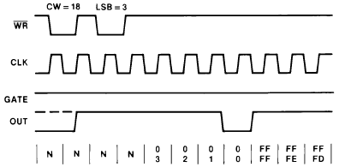
MODE 4: Software Triggered Strobe

Slide 27
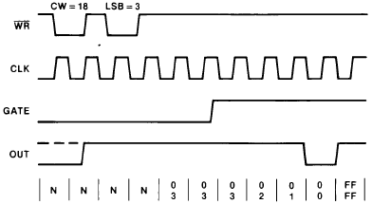
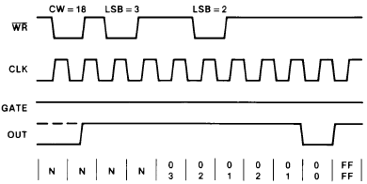

Slide 28
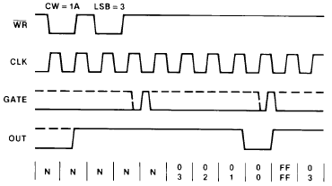
MODE 5 : Hardware Triggered Strobe (Retriggerable)

Slide 29
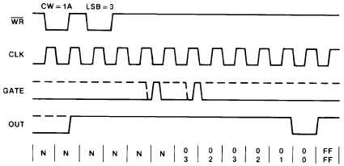
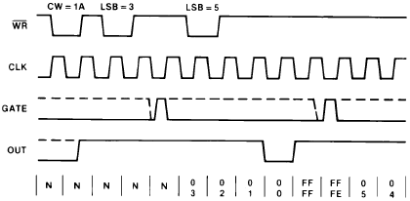

Slide 30
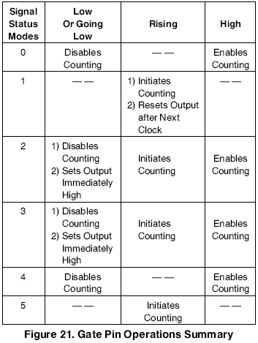

Slide 31
Applications of 8254
Real time clock
Event-counter
Digital one-shot
Programmable rate generator
Square wave generator
Binary rate multiplier
Complex waveform generator
Complex motor controller

Slide 32
References
Microprocessors and Interfacing by Douglas V. Hall, TMH Publication.
Intel 8254 data sheet (www.datasheetcatalog.com)

Slide 33

Happy Learning

